Slide 1

Safe
Surfer
Know what you’re giving up, then take it back
Presented By:
Ellyx Jolley, Matt Howa, Matt Willden

Slide 2
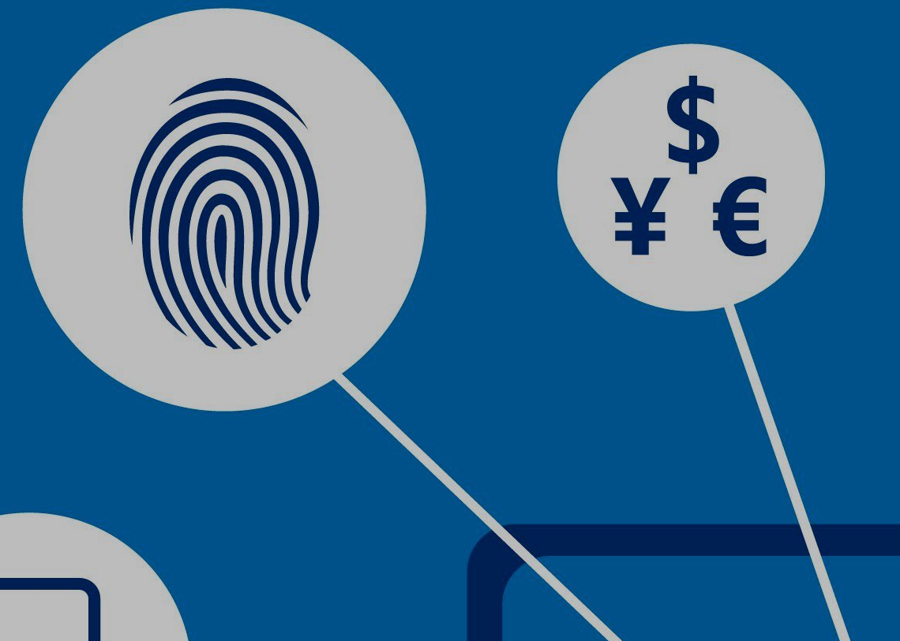
Motivation
Safe Surfer
In an ever expanding online world, is it possible to keep your anonymity, and still use the internet?
Even tech savvy people struggle to understand how to keep their information private
This is increasingly more difficult for inexperienced professionals
Most people have no idea how much information they are giving the world

Slide 3
Who Cares?…
Safe Surfer
Digital fingerprinting grosses over $20 billion a year
Size of data captured by industry doubles every 1.2 years
Malicious “hackers” grow ever more present
Political / Legal terms of privacy is largely unregulated
Fully deterring fingerprinting tech doesn’t exist

Slide 4

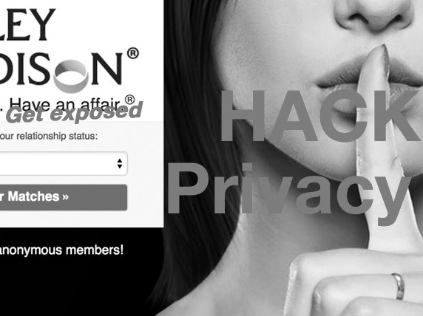

Your information, Someones Treasure
Safe Surfer
If a malicious party obtained identifiable access logs for just one of the websites that know your name, and view logs for just one of the adult websites you’ve visited, it could infer with very high probability - beyond plausible deniability - a list of porn you've viewed. At any time, somebody could post a website that allows you to search anybody by email or facebook username and view their porn browsing history. All that's needed are two nominal data breaches and an enterprising teenager that wants to create havoc.
-Brett Thomas

Slide 5

Why this is Different
safe Surfer
No application exists to fully protect privacy
Existing applications are modular, requiring multiple interactions
The best software will struggle to be anything more than “reactive”
User education is critical to limiting privacy infringement

Slide 6
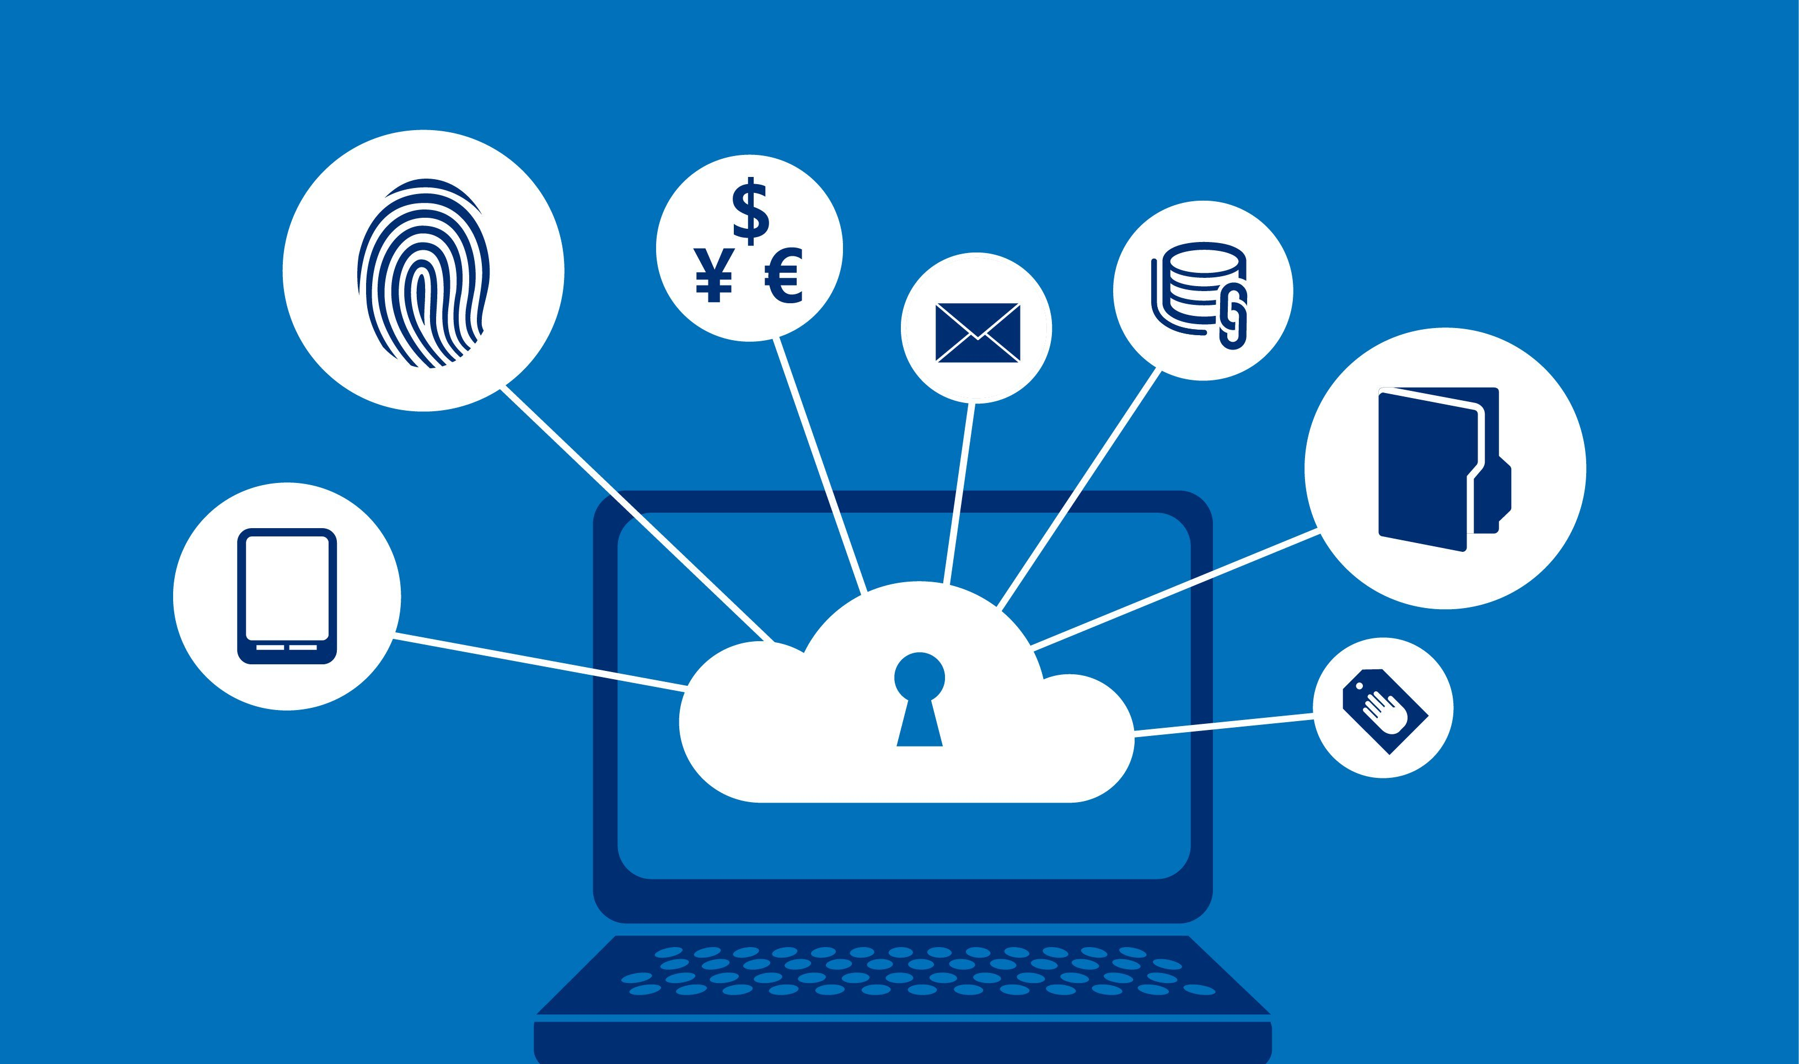
Our Approach
Safe Surfer
Educate users while protecting them
Show the user what they are exposing
Help them hide what is possible
Tell them what cannot be hidden
Extensible privacy protection; in one place
Plug in existing open source privacy modules

Slide 7
Our Features
Safe Surfer
Educating:
Show cookie details, alert with newly created on
Alert when location services are used or enabled
Alert when media I/O services are used or enabled
Alert unsecured connections
Display browser privacy settings
Show how hardware information is exposed
Show how safe current browser is

Slide 8
Our Features
Safe Surfer
Protecting:
Plug in tracking protection
Plug in add blocking
Alert unsecured connections
Display browser privacy settings
Show how hardware information is exposed

Slide 9
Evaluation
Safe Surfer

Slide 10
Demo
Safe Surfer

Slide 11

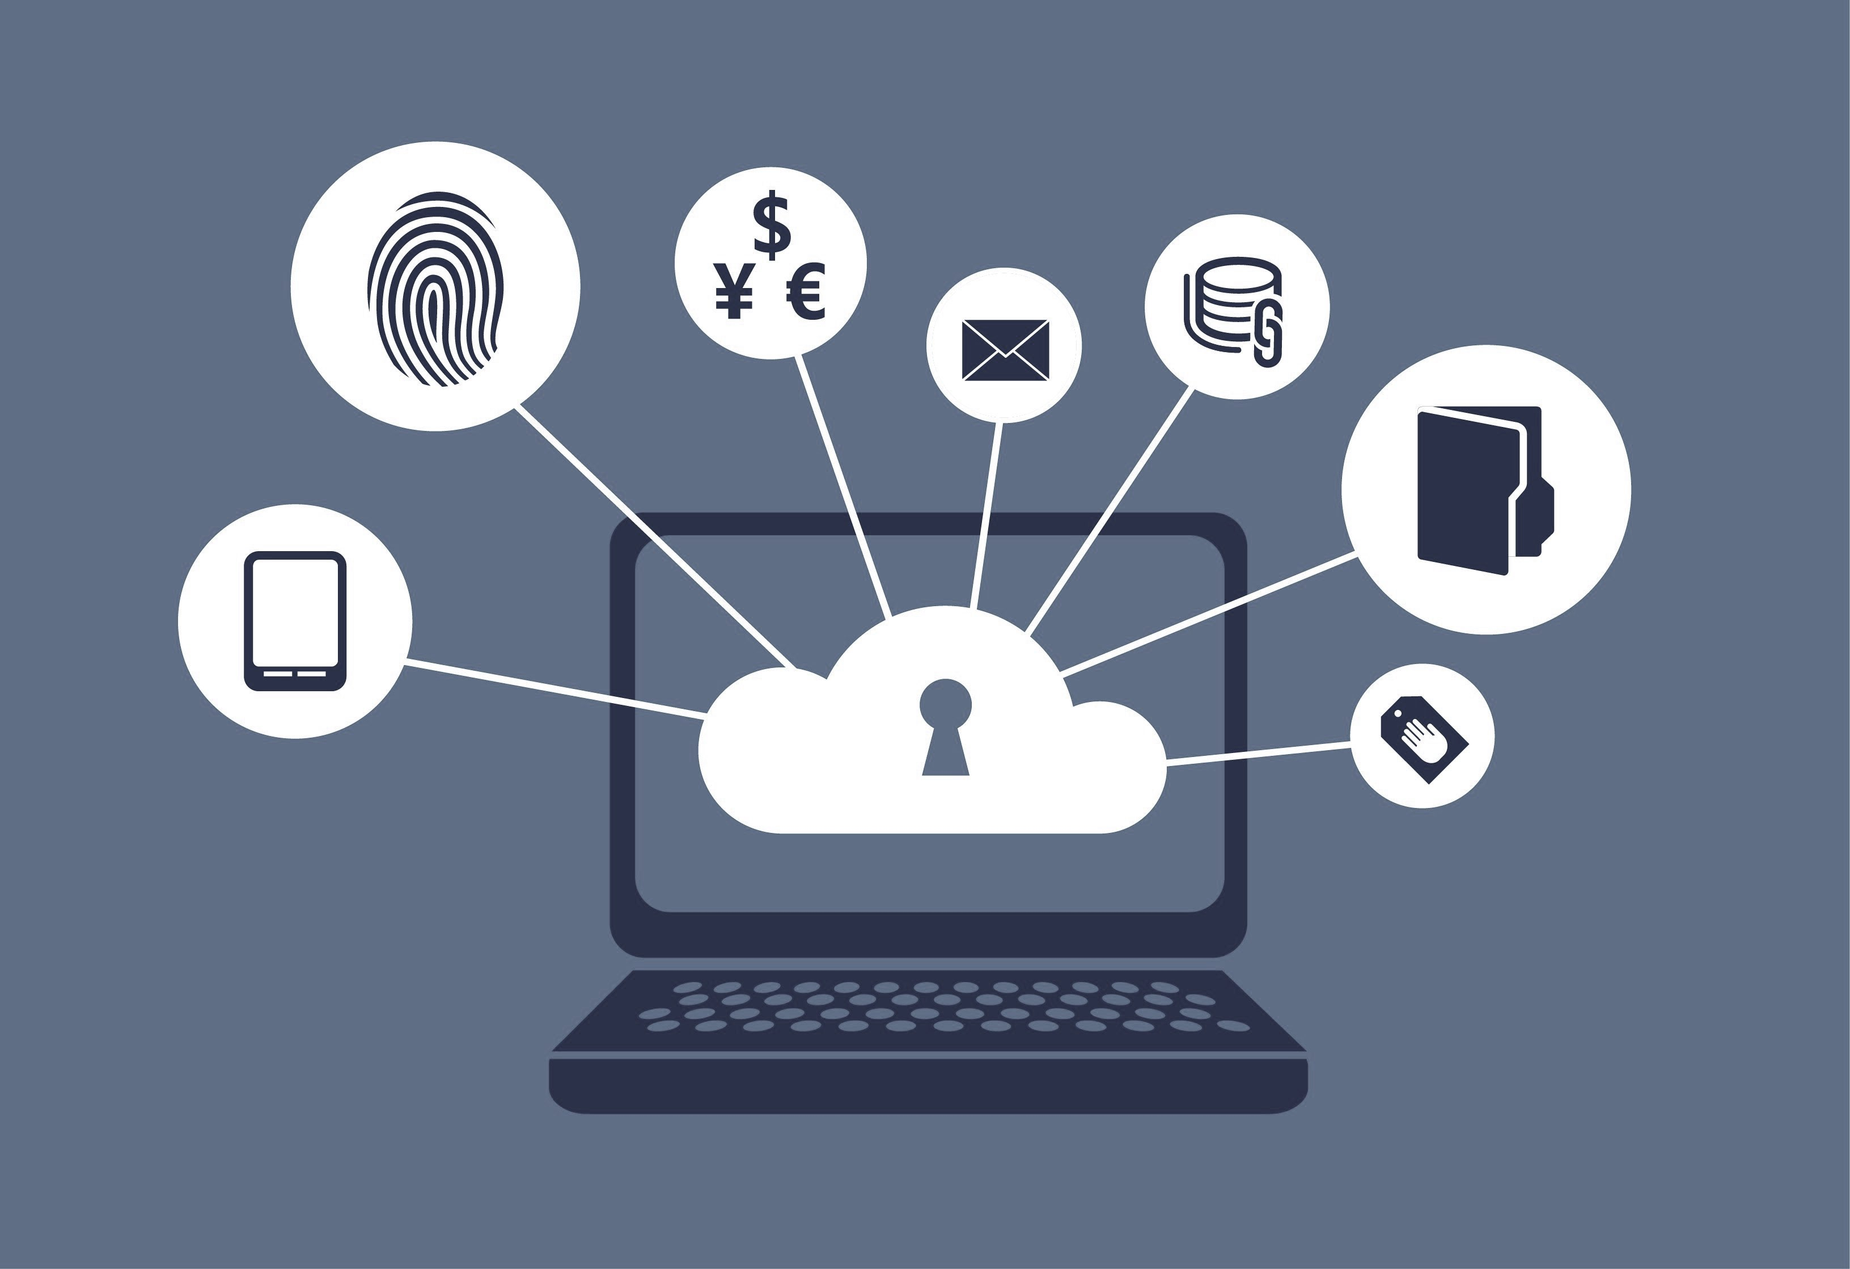

Future / What ifs
Safe Surfer
Full OS integration
Time constraints made us focus on browser protection
More privacy protection support
Integrating more open source privacy protection services
Privacy Protection Ranking
Assign a privacy rank based on the users settings
Investigate more privacy protection techniques
Digital profiling is a huge area of study

Slide 12
Conclusion
Safe Surfer
Digital profiling is only going to get more ubiquitous, as Big Data science finds better ways to process the vast amounts of information.
There is a limit to what you can block, while still having a useable online experience
Educating users to understand online privacy can be more successful than a complex program

Slide 13
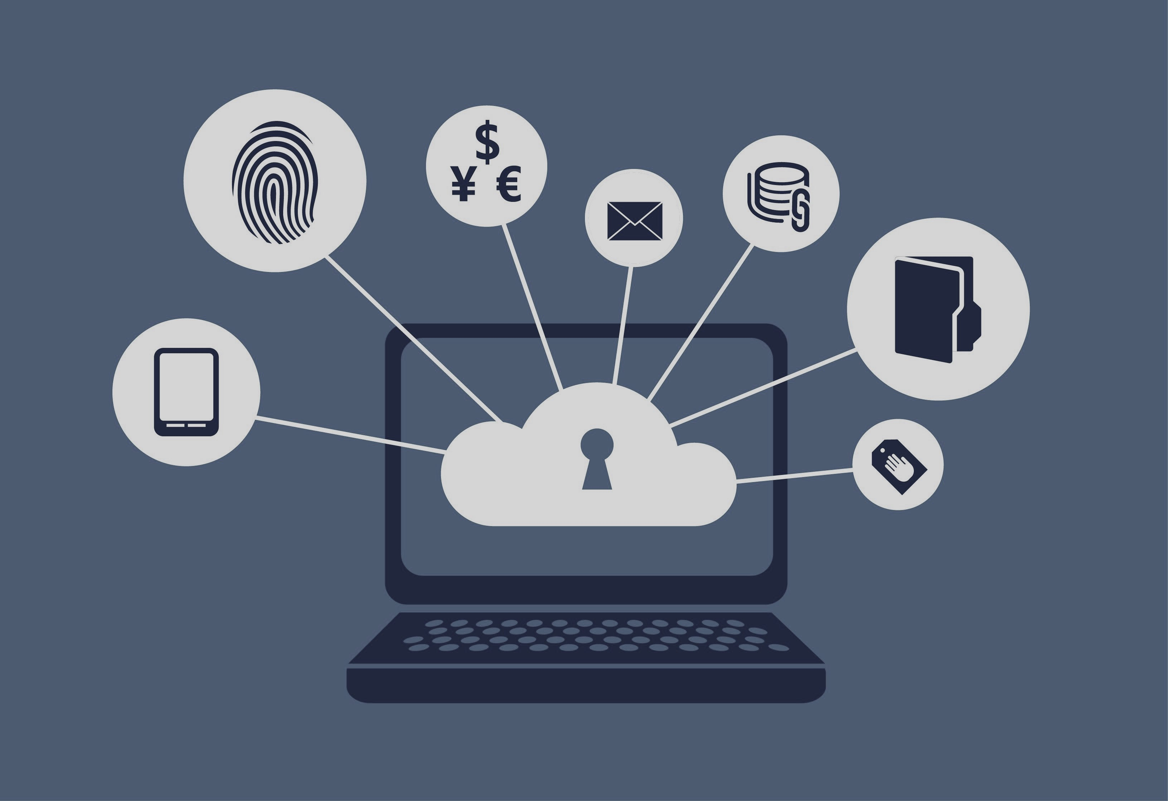
Thank You
Questions
Comments ?

Slide 14
Sources
Safe Surfer
http://www.darkreading.com/risk-management/browser-fingerprinting-9-facts/d/d-id/1112056?
http://www.slideshare.net/BernardMarr/big-data-25-facts/5-The_total_amountof_data_beingcaptured
http://www.pewinternet.org/2013/09/05/anonymity-privacy-and-security-online/
http://www.mediapost.com/publications/article/260863/digital-fingerprinting-poses-real-danger-to-inte.html
https://panopticlick.eff.org/static/browser-uniqueness.pdf

